Slide 1
Michael Radel DeVry University January 2023 Programming CEIS 110 Python
Weather Database
(Mesa, AZ) analysis using Python

Slide 2
Introduction to Presentation
Design and implantations of database
Creating a weather database.
Manipulating data using Python and SQL.
Querying data into graphical interfaces.
Using data for predictive outcomes.

Slide 3
CEIS110 Week 1
Design and Library setup
Michael Radel
January 2023

Slide 4
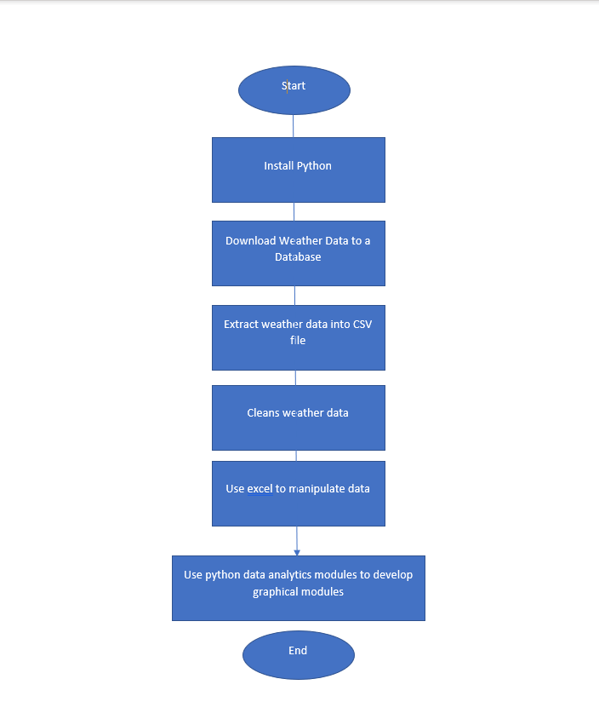
Flowchart
Include the following processes:
Install python
Download weather data to a database.
Extract weather data from database into a comma separated file with python
Cleanse weather data
Use Excel to manipulate data
Use python data analytics modules to develop graphical models

Slide 5
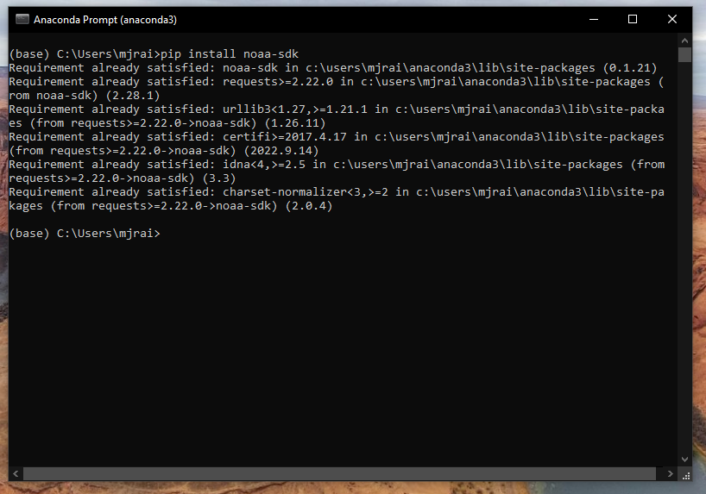
Software Inventory (Screenshots)
Include screenshot of NOAA-SDK library installed
Ensure result "Successfully installed noaa-sdk" of pip install command is visible in your screenshot.

Slide 6
CEIS110 Module 2
Downloading weather data from the weather.db database

Slide 7
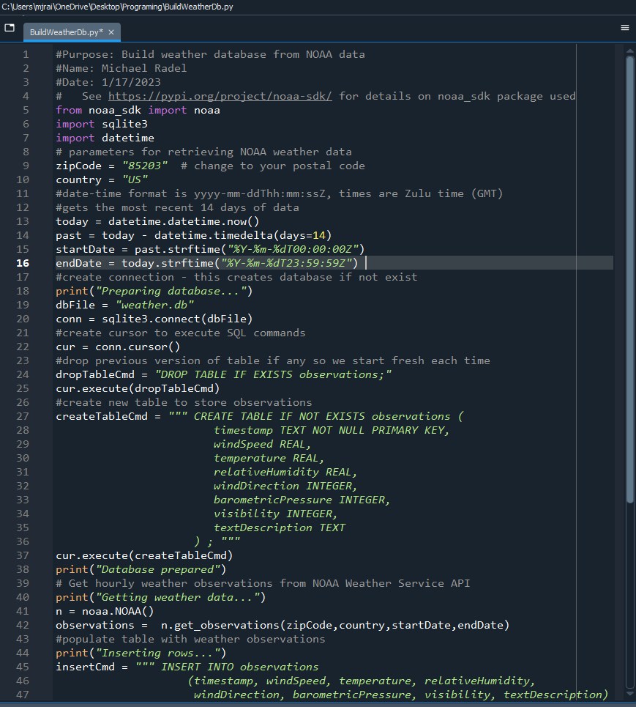
BuildWeatherDb.py Code (Screenshot)
Screenshot of code in Spyder

Slide 8
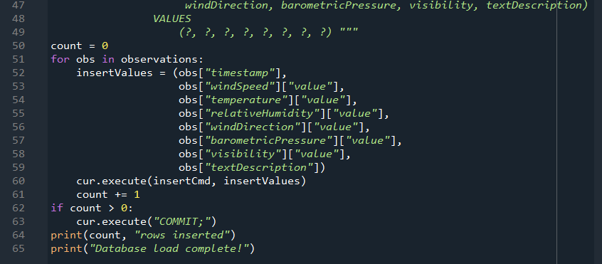
BuildWeatherDb.py Code (Screenshot) Cont
Screenshot of code in Spyder
Must have your name and date in comments
Must have your zip code

Slide 9
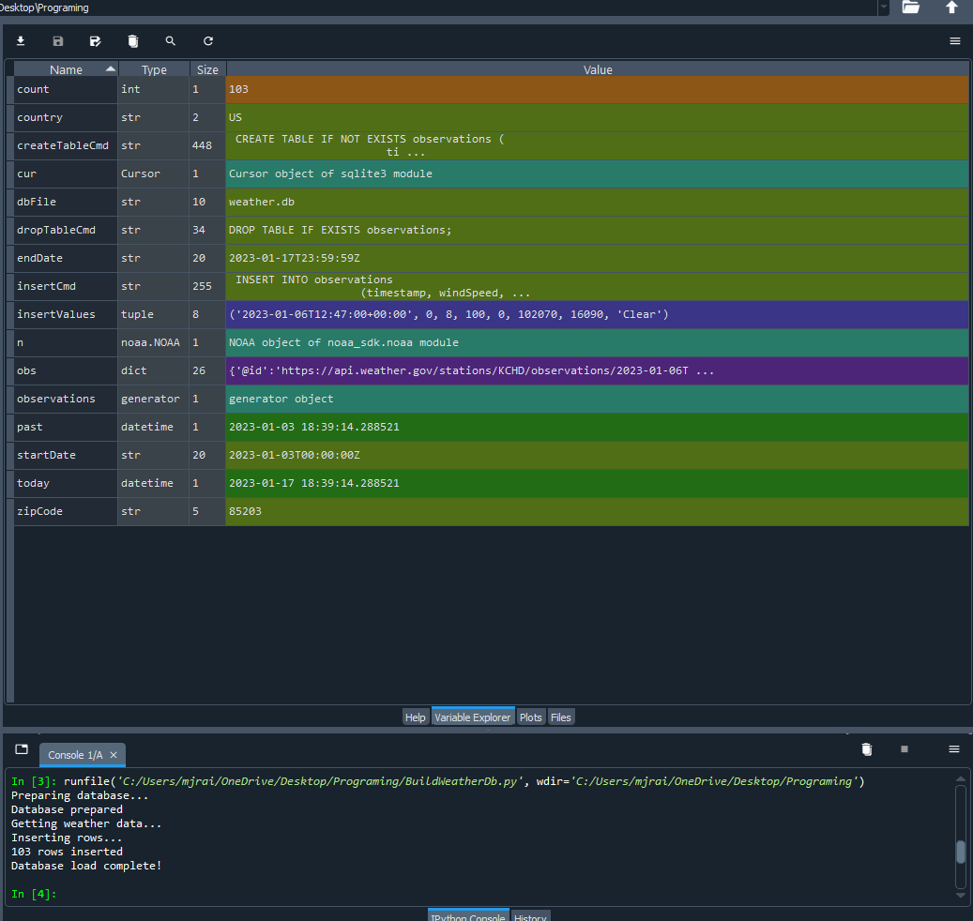
Python Console (Screenshot)
Screenshot of program output in Python console showing program executed successfully

Slide 10
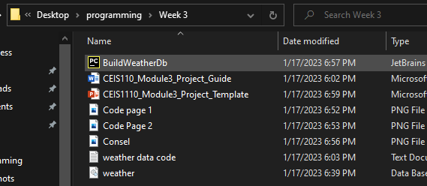
Weather.db File (Screenshot)
Screenshot of Windows Explorer showing database file Weather.db was created

Slide 11
CEIS110 Week 3
Querying the database with SQL

Slide 12
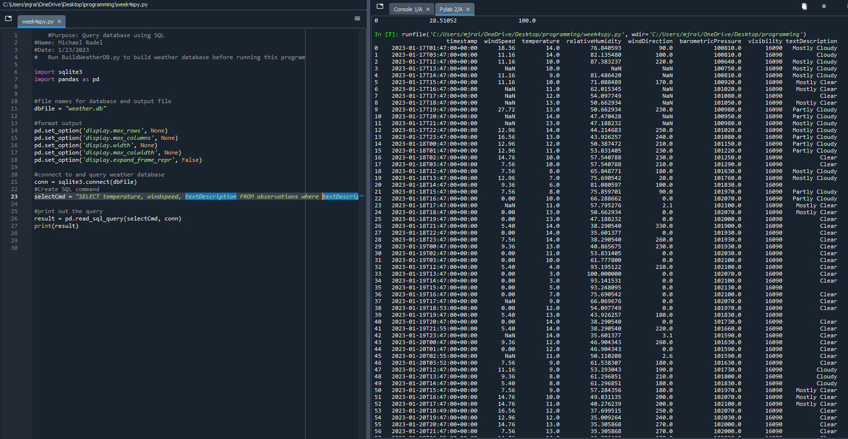
Query to retrieve all columns and all rows (Screenshot)
Screenshot of SQL query command and results

Slide 13
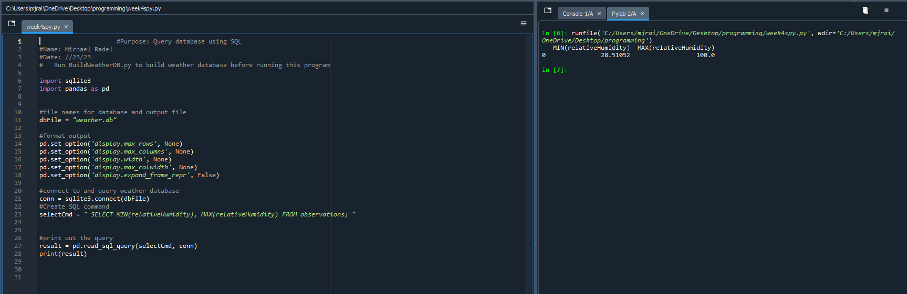
Query to retrieve lowest and highest temperatures (Screenshot)
Screenshot of SQL query command and results

Slide 14
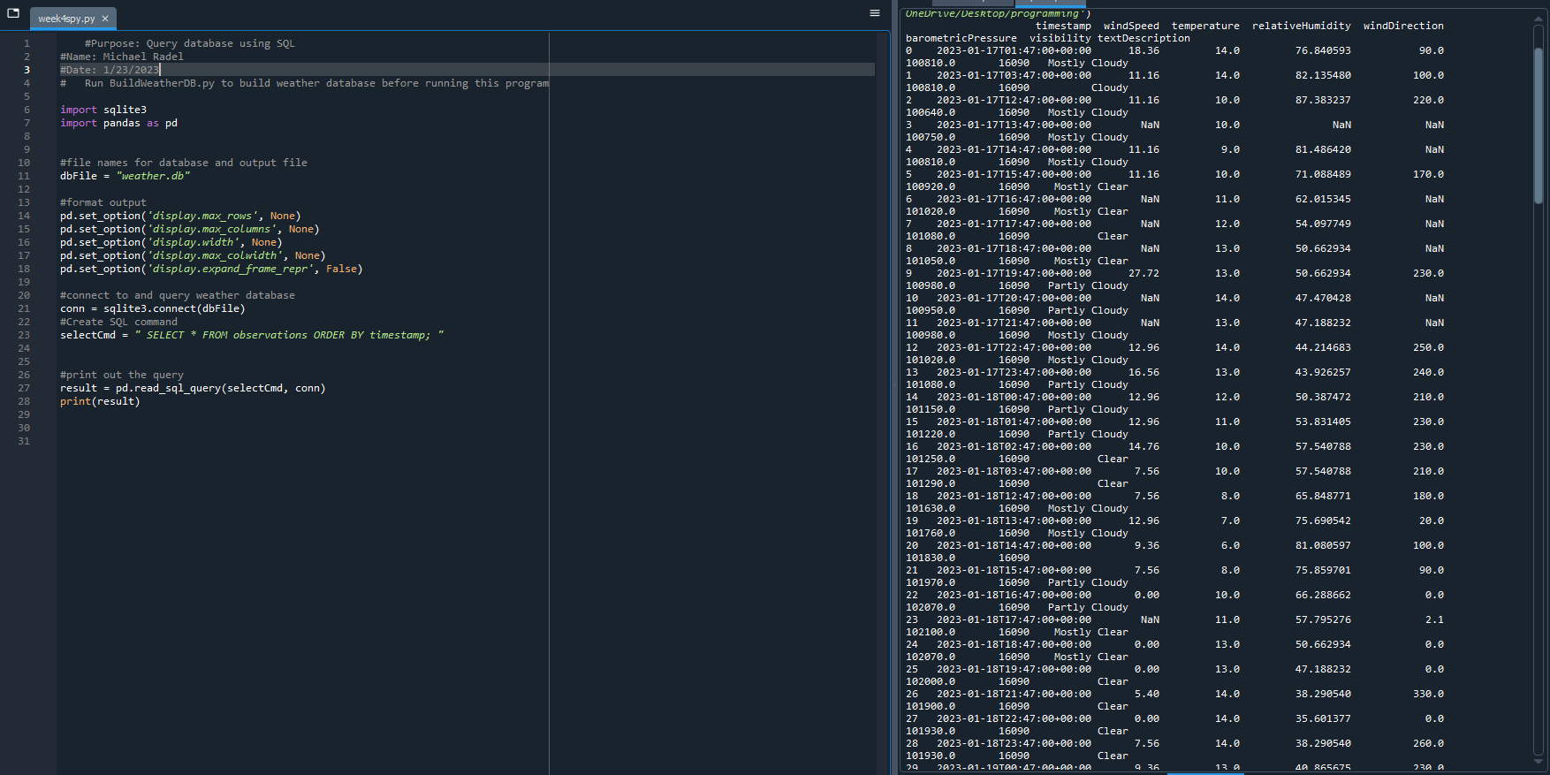
Query to retrieve all clear days (Screenshot)
Screenshot of SQL query command and results

Slide 15
CEIS110 Week 4
Querying and manipulating data with SQL and Python

Slide 16
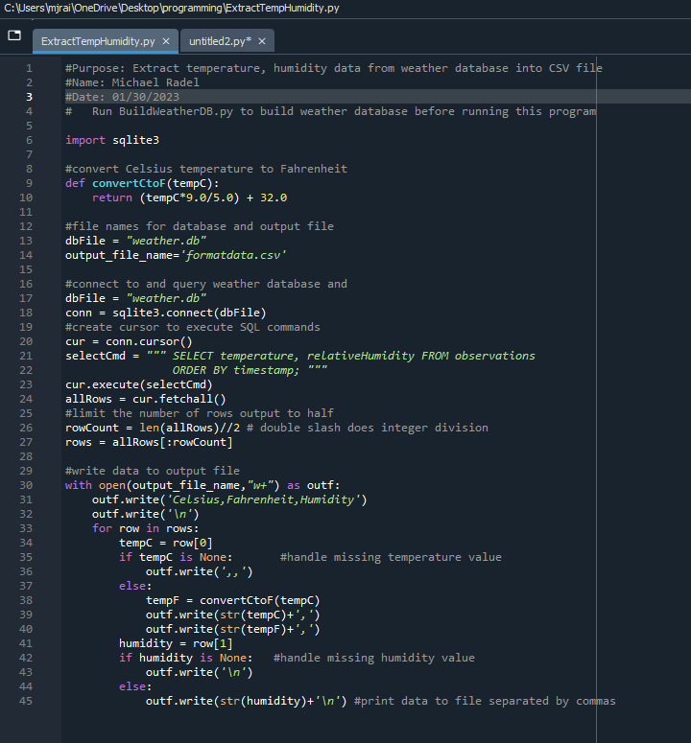
Python code (Screenshot or file)
ExtractTempHumidity.py Python code with your name and date in comments

Slide 17
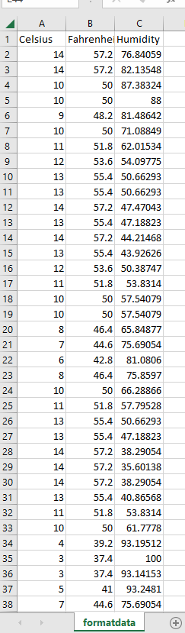
Retrieve and Convert Data to CSV Format (Screenshot)
Formatdata file open in Excel showing 3 columns of data

Slide 18
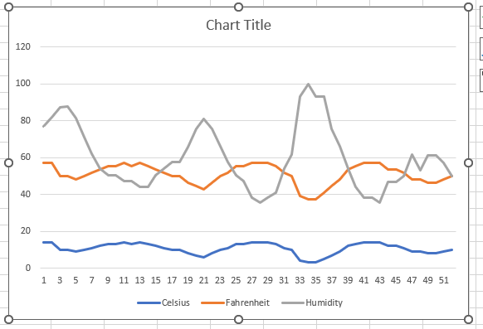
Temperature and Humidity Chart
Excel chart based on temperature and humidity data from database

Slide 19
CEIS110 Week 5
Develop Graphical Models and Interpret Results

Slide 20
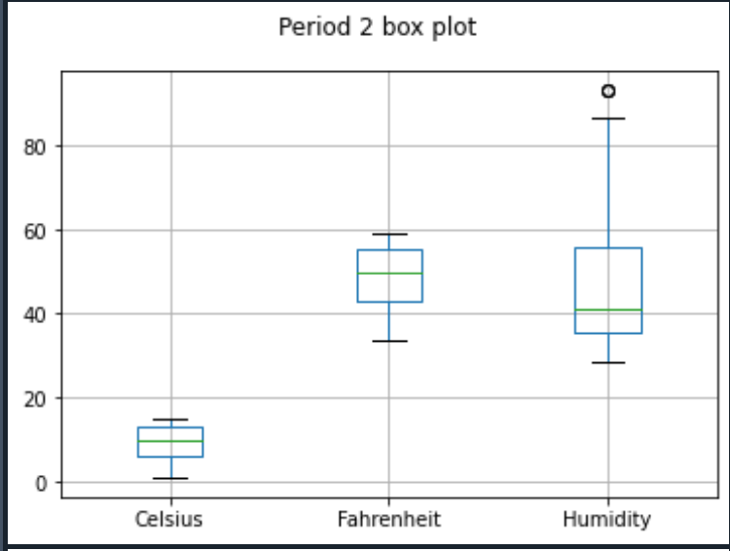
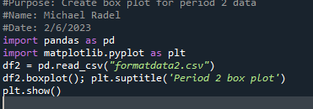
Plot #1
Plot and code used to generate it
Box

Slide 21
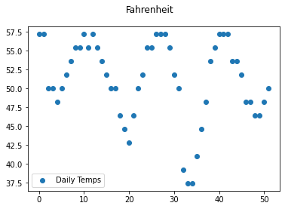
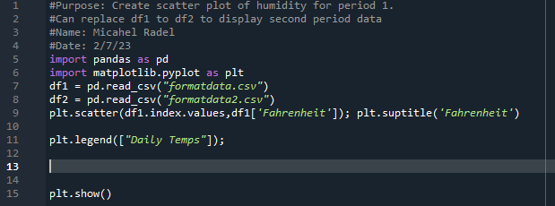
Plot #2
Plot and code used to generate it
Scatter

Slide 22
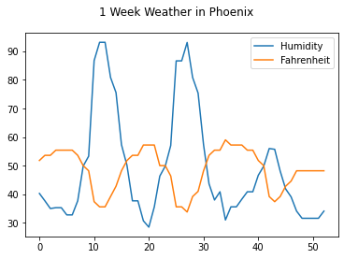
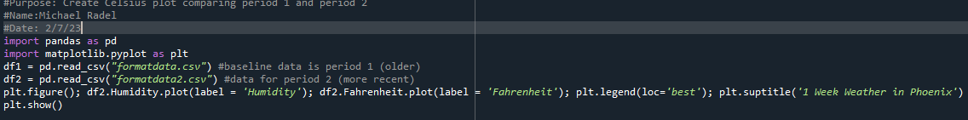
Analysis
Think of your own question and create a chart/graph to answer it
Your own question:
Does Humidity lower when temperature increases?
Answer supported by Chart:
As humidity went up the temperature would decrease, presenting a rainy day .

Slide 23

Prediction
Develop a prediction based on the data. What variations in temperature and humidity do you expect over the next few hours or days? How would humidity change if temperature goes up or down?
Over the next 10 days I see a spike in humidity that will then cause a decrease in temperature over the period. As they to meat at a middle ground the have a full inverse reaction with each other.

Slide 24
CESIS 110 Week 6
Challenges, Skills, Conclusion

Slide 25

Challenges
When it came specifically to Python
Memory of punctation was difficult
Spacing with IF statements
For my self was remerging to add comments and how important that can be!
When creating the database at the begging I didn’t use proper organization and had to move my weather.db file to a different folder.

Slide 26

Career Skills Required in Programming
Programming in Python
SQl
HTML
C++
Web Development
JavaScript
Cloud Computing

Slide 27

Conclusion
Python has a large footprint in the programming market. For simple reasons such as:
Ease of use
Ability to learn at a young age and adaptability
Open sours platforms
As big data is collected , it can be used for creating predictions and modeling data .

